Slide 1
Project Management
CM4 – CEM4
2011-2012

Slide 2
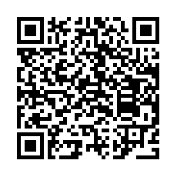
Paul Vesey, B.Eng. (Hons), MIE, MIEI
Email paul.vesey@lit.ie
Room 13B09
Internal Tel No. 166
External Tel No. 061 490166

Slide 3
Class Exercise
Q1 – What do you think Project Management is?
Q2 – Why learn about Project Management?
Q3 – What expectations do you have of this subject/class?

Slide 4


What to Expect
Resources will be available on
CM4 - Enrolment password ‘k97c3no696’.
CEM4 - Enrolment password ‘dv0mjg5409’.
Turn-It-In will be used for assignments.
Class ID Number is ‘4329866’
Enrolment Password is ‘knr58943ub452’
You may have to create a ‘User Profile’
Attendance and Lectures and Tutorials is vital.

Slide 5
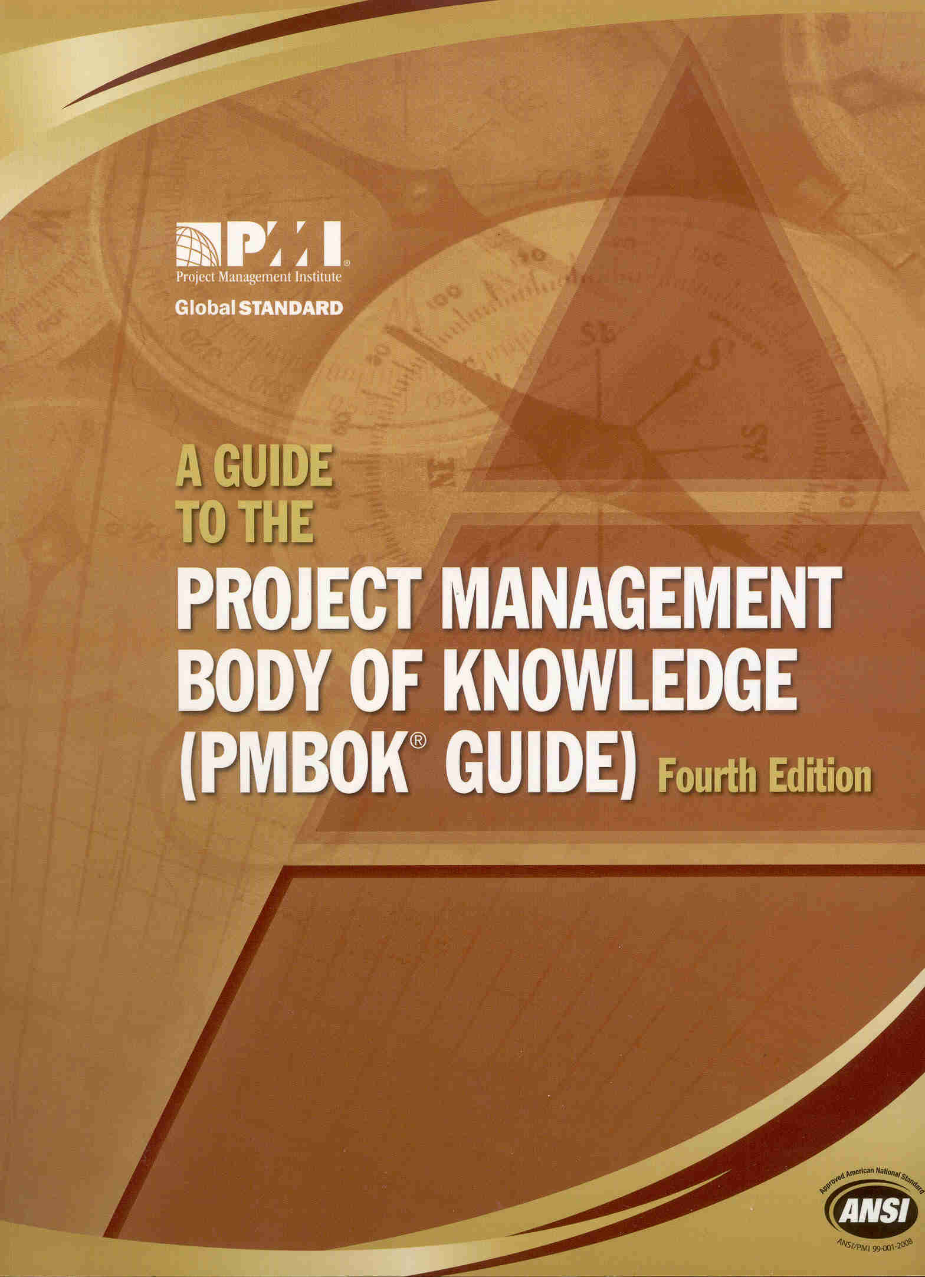
Course Text
A Guide to the Project Management Body of Knowledge – 4th Edition
Published by The Project Management Institute (PMI)
ISBN 978-1-933890-51-7

Slide 6
Syllabus
2 hours Lectures per week
1 hour Tutorial per week
70% Examination
30% Coursework

Slide 7
Syllabus
Project Management Process
Introduction to Project Management and the Project Management Process.
Project Management Body of Knowledge (PMBOK).
Systems Theory
Project Team
Role of the project manager and the project team.
Effective teams.
Conflict resolution within the team.
I.E.I. Code of Ethical Conduct.

Slide 8
Syllabus
The Planning and Scheduling Process
Conceptualisation / scope management,
project time management,
project cost management
Methods of Measuring Work Progress
Updating of schedules (bar charts, networks, line of balance, time chainage).
Earned value and forecasting.
Trend analysis.

Slide 9
Syllabus
Project Human Resource Management
Staffing,
motivation, leadership, groups,
power, delegation, authority
performance appraisal.
Project Quality Management
Policy
planning,
assurance,
control,
improvement.

Slide 10
Syllabus
Project Risk Management
Identification, quantification, mitigation
Decision tree analysis.
Sensitivity analysis.
Project Procurement Management
Planning
solicitation
source selection.
contract administration
contract close out.

Slide 11
Syllabus
Project Communications Management
Planning
information distribution
progress reporting
storage / archiving.
Value Management
Value planning,
value engineering
value review.

Slide 12
Coursework
Both CA assignments issued via Moodle on the 19th of September
Coursework 1 – due 23rd November 2011
10% of the 30% allocated
Coursework 2 – due 14th March 2012
20% of the 30% allocated
Start them both early….

Slide 13
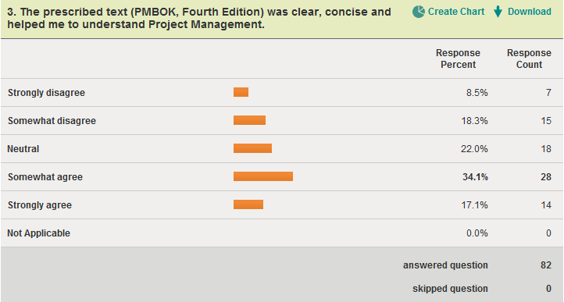
What to Expect
Feedback survey conducted May 2011 using SurveyMonkey
http://www.surveymonkey.com

Slide 14
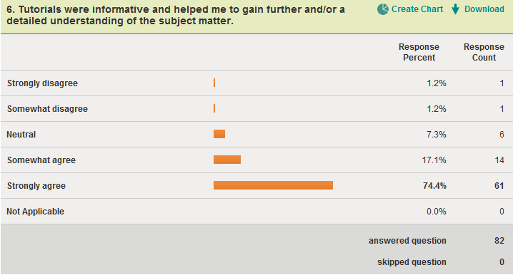
What to Expect
Feedback survey conducted May 2011 using SurveyMonkey
http://www.surveymonkey.com

Slide 15
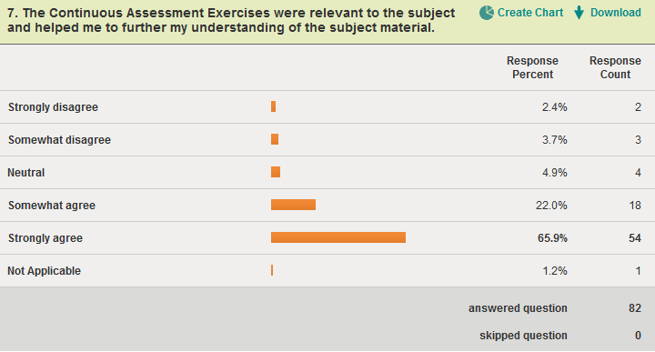
What to Expect
Feedback survey conducted May 2011 using SurveyMonkey
http://www.surveymonkey.com

Slide 16
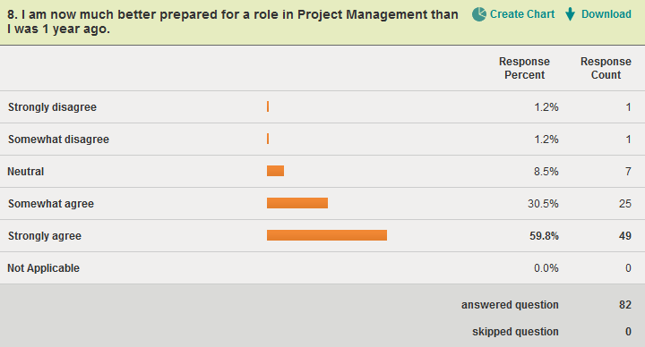
What to Expect
Feedback survey conducted May 2011 using SurveyMonkey
http://www.surveymonkey.com

Slide 17
What is Expected
Don’t be late…
Read the material provided, and around the subject.
Ask Questions…

Slide 18
Questions?

